Slide 1
ESCAPE Data Collection
Sensor Layout
June/October 2018
AFRL:
Peter Zulch, AFRL RIGC

Slide 2
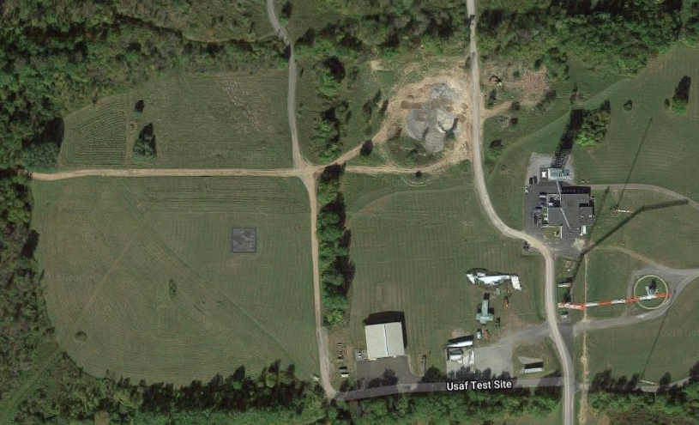
MTRI P-RF/AFRL EO Locations
Dates: 06/25/2018
06/29/2018
Scenarios: 1, 2, 8
11 – MTRI P-RF
01– AFRL EO
MTRI ESCAPE Payload Locations
MTRI UHF Radar Location
AFRL Acoustic Sensor
AFRL Seismic Sensors
Radar, Escape, MTRI P-RF
Control – Walkup tower
Personnel Location
04-MTRI EO
05-MTRI IR
14-MTRI P-RF
21-MTRI Radar
06-MTRI EO
07-MTRI IR
15-MTRI P-RF
Dir., Vehicle Staging
Emitter Control
12 – MTRI P-RF
02– AFRL EO
31-AFRL Acoustic
SUAS Control
Acoustic
41-AFRL Seismic
Network
AFRL
Cameras
Seismic
13 – MTRI P-RF
03 – AFRL EO
08-MTRI EO
09-MTRI IR
16-MTRI P-RF

Slide 3
MTRI P-RF/AFRL EO Locations
Dates: 10/16/2018
10/19/2018
Scenarios: 1, 2
12 – MTRI P-RF
01– AFRL EO
MTRI ESCAPE Payload Locations
MTRI UHF Radar Location
AFRL Acoustic Sensor
AFRL Seismic Sensors
Radar, Escape, MTRI P-RF
Control – Walkup tower
Personnel Location
04-MTRI EO
05-MTRI IR
14-MTRI P-RF
21-MTRI Radar
06-MTRI EO
07-MTRI IR
15-MTRI P-RF
Dir., Vehicle Staging
Emitter Control
13 – MTRI P-RF
02– AFRL EO
31-AFRL Acoustic
SUAS Control
Acoustic
41-AFRL Seismic
Network
AFRL
Cameras
Seismic
11 – MTRI P-RF
03 – AFRL EO
08-MTRI EO
09-MTRI IR
16-MTRI P-RF

Slide 4
Date: 06/26/2018
Scenarios 3,4,6,7
MTRI P-RF/AFRL EO Locations
11 – MTRI P-RF
01– AFRL EO
MTRI ESCAPE Payload Locations
MTRI UHF Radar Location
08-MTRI EO
09-MTRI IR
16-MTRI P-RF
AFRL Acoustic Sensor
AFRL Seismic Sensors
Radar, Escape, MTRI P-RF
Control – Walkup tower
Personnel Location
04-MTRI EO
05-MTRI IR
14-MTRI P-RF
21-MTRI Radar
12 – MTRI P-RF
02– AFRL EO
31-AFRL Acoustic
Acoustic
41-AFRL Seismic
Network
AFRL
Cameras
06-MTRI EO
07-MTRI IR
15-MTRI P-RF
SUAS Control
Test Director
13 – MTRI P-RF
03 – AFRL EO
Seismic

Slide 5
MTRI P-RF/AFRL EO Locations
Date: 10/18/2018
Scenarios 5,7
12 – MTRI P-RF
01– AFRL EO
MTRI ESCAPE Payload Locations
MTRI UHF Radar Location
08-MTRI EO
09-MTRI IR
16-MTRI P-RF
AFRL Acoustic Sensor
AFRL Seismic Sensors
Radar, Escape, MTRI P-RF
Control – Walkup tower
Personnel Location
04-MTRI EO
05-MTRI IR
14-MTRI P-RF
21-MTRI Radar
13 – MTRI P-RF
02– AFRL EO
31-AFRL Acoustic
Acoustic
41-AFRL Seismic
Network
AFRL
Cameras
06-MTRI EO
07-MTRI IR
15-MTRI P-RF
SUAS Control
Test Director
11 – MTRI P-RF
03 – AFRL EO
Seismic

Slide 6
MTRI P-RF/AFRL EO Locations
Dates: 06/26/2018
Scenario 7
11 – MTRI P-RF
01– AFRL EO
MTRI ESCAPE Payload Locations
MTRI UHF Radar Location
AFRL Acoustic Sensor
AFRL Seismic Sensors
Radar, Escape, MTRI P-RF
Control – Walkup tower
Personnel Location
04-MTRI EO
05-MTRI IR
14-MTRI P-RF
21-MTRI Radar
12 – MTRI P-RF
02– AFRL EO
31-AFRL Acoustic
Acoustic
08-MTRI EO
09-MTRI IR
16-MTRI P-RF
41-AFRL Seismic
Network
06-MTRI EO
07-MTRI IR
15-MTRI P-RF
AFRL
Cameras
SUAS Control
Test Director
13 – MTRI P-RF
03 – AFRL EO
Seismic

Slide 7
MTRI P-RF/AFRL EO Locations
Dates: 10/18/2018
Scenarios 9
12 – MTRI P-RF
01– AFRL EO
MTRI ESCAPE Payload Locations
MTRI UHF Radar Location
AFRL Acoustic Sensor
AFRL Seismic Sensors
Radar, Escape, MTRI P-RF
Control – Walkup tower
Personnel Location
04-MTRI EO
05-MTRI IR
14-MTRI P-RF
21-MTRI Radar
13 – MTRI P-RF
02– AFRL EO
31-AFRL Acoustic
Acoustic
08-MTRI EO
09-MTRI IR
16-MTRI P-RF
41-AFRL Seismic
Network
06-MTRI EO
07-MTRI IR
15-MTRI P-RF
AFRL
Cameras
SUAS Control
Test Director
11 – MTRI P-RF
03 – AFRL EO
Seismic

Slide 8
Naming Convention
Each collection device will have a specific naming convention for each data file of collected data
D: Device # (refer to map)
S: Scenario # (provided by test coordinator)
R: Run # (provided by test coordinator)
Date: YearMonthDay, yyyymmdd
# are formatted: 01, 2a, 2b, 2c, 03, etc.
d##s##r##yyyymmdd.***

